Slide 1
LUMBOSACRAL PLEXUS
BY
F.O. OPOOLA (Ph.D)

Slide 2
LEARNING OBJECTIVE
Describe the formation of lumbosacral plexus (site, roots)
List the main branches of lumbosacral plexus
Describe the important Applied Anatomy related to the lumbosacral plexuses.

Slide 3
What is the lumbosacral plexus?
The lumbosacral plexus is a network of nerve fibers, derived from the roots of lumbar and sacral spinal nerves that branch out to form the nerves supplying the lower limb.
In the human body, there are 31 pairs of spinal nerves corresponding to a segment of the vertebral column: cervical (C1-C8), thoracic (T1-T12), lumbar (L1-L5), sacral (S1-S5), and coccygeal.
In the cervical and lumbar regions, the corresponding spinal nerves unite to form the brachial and lumbosacral plexuses, from which arise the nerves of the upper and lower limbs, respectively.

Slide 4
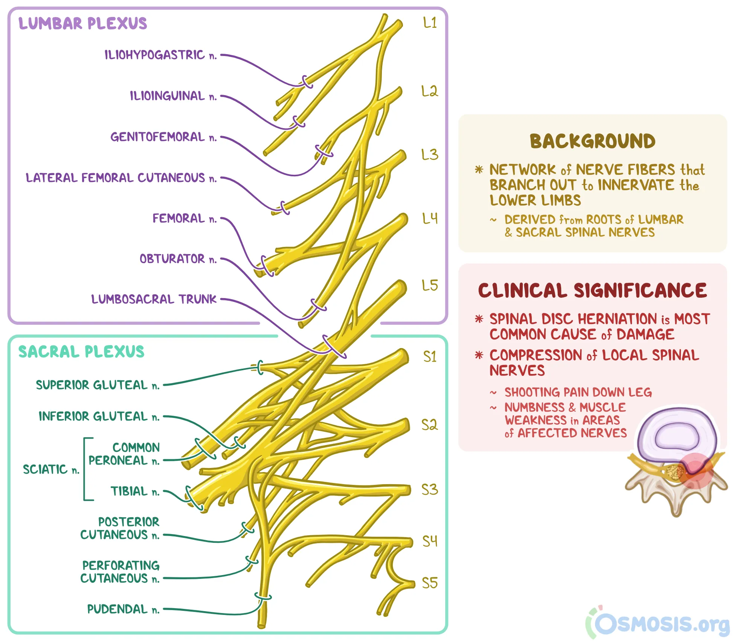

Slide 5
Where is the lumbosacral plexus located?
The lumbosacral plexus is formed by the anterior rami (i.e., branches) of spinal nerves L4 to L5 and S1 to S4.
It is located on the posterolateral wall of the lesser pelvis, adjacent to the lumbar spine.
The lumbosacral plexus then embeds itself into the psoas major muscle and later emerges in the pelvis.

Slide 6
What nerves are found in the lumbosacral plexus?
The lumbosacral plexus includes nerves that arise from both the lumbar plexus and sacral plexus.
From superior to inferior, the major nerves that branch off the lumbar plexus include the iliohypogastric nerve, ilioinguinal nerve, genitofemoral nerve, lateral femoral cutaneous nerve, obturator nerve, and femoral nerve, as well as the lumbosacral trunk.
The ilioinguinal and iliohypogastric nerves arise from the L1 spinal nerve and provide motor supply to some muscles of the abdominal wall, as well as sensory inputs to the skin of the groin area.

Slide 7
The genitofemoral nerve arises from the L1 and L2 spinal nerves and then divides into a genital and femoral branch.
In individuals assigned males at birth, the genital branch supplies the skin of the scrotum and cremaster muscle; in individuals assigned female at birth, it supplies the skin around the mons pubis and labia majora.
The femoral branch of the genitofemoral nerve supplies the skin of the upper anteromedial thigh.

Slide 8
In the lower part of the lumbosacral plexus, the first branch is the sciatic nerve, which is the largest nerve in the human body.
This nerve arises from spinal nerves L4 to S3 and gives off branches that supply the hip joint, posterior muscles of the thigh, and all the muscles of the leg and foot.
the pudendal nerve, which arises from spinal nerves S2, S3, and S4, provides sensory inputs to the external genitalia. as well as the muscular input to perineal muscles.

Slide 9
The superior gluteal nerve, which arises from L4, L5, and S1, and the inferior gluteal nerve, which arises from L5, S1, and S2, provide motor supply to the muscles of the gluteal region.
The lumbosacral plexus also gives off five nerves that are named by the muscle they innervate.
These include the quadratus femoris nerve (L4-S1), the obturator internus nerve (L5-S2), the piriformis nerve (S1-S2), and nerves to the levator ani and coccygeus, which arise from S3 and S4.
Finally, the sacral plexus gives off the posterior cutaneous nerve and perforating cutaneous branches, which supply the skin of the buttocks and posteromedial thigh.

Slide 10
lumbosacral plexus
The lumbosacral plexus is formed by the anterior rami of spinal nerves L4, L5, and S1 to S4, which are branches of the lumbar plexus and sacral plexus.
Upon their exit from the spinal cord, these nerves divide into anterior and posterior branches which become the peripheral nerves that serve to innervate various structures of the pelvis and lower limbs.
The largest nerve in the human body, the sciatic nerve, exits from the lumbosacral plexus to innervate most of the lower limb muscles.

Slide 11
Next, the posterior branches of L2 and L3 give rise to the lateral femoral cutaneous nerve, supplying sensation to the skin on the lateral side of the thigh.
Inferior to this nerve, the posterior branches of L2 to L4 become the femoral nerve, which gives off motor branches to all the muscles of the anterior compartment of the thigh, as well as cutaneous branches that supply most of the skin of the anterior thigh.
On the other hand, the anterior branches of L2 to L4 become the obturator nerve, which innervates the obturator externus and all the muscles of the medial compartment of the thigh except part of the adductor magnus and the pectineus muscle.
The obturator nerve also supplies sensation to the skin on the medial side of the upper thigh.
Finally, the lumbosacral trunk arises from the descending part of L4, which travels through the anterior surface of the sacrum, uniting with L5 and forming the lumbosacral plexus.

Slide 12
Lumbosacral Plexus Sciatic Nerve (The largest nerve of the body)
Origin: • from sacral plexus (L4, L5, S1, S2, & S3) • It is one of the terminal branch of sacral plexus.
Course: •Leaves the pelvis through greater sciatic foramen, below piriformis & passes in the gluteal region (between ischialtuberosity& greatertrochanter) then to posterior compartment of thigh

Slide 13
Divides : into tibial & common peroneal(fibular) nerves
Injury: • Injury will affect the flexion of knee, extension o f hip, all movements of leg & foot, as well as loss of sensation of skin of leg and foot (except areas supplied by saphenous branch of femoral nerve. Ischial tuberosity Lumbosacral Plexus Sciatic Nerve (The largest nerve of the body)
Course: •Leaves poplitealfossa & turns around the lateral aspect of neck of fibula.
Then divides into: 1.Superficial peroneal: descends into lateral compartment of leg. 2.Deep peroneal: descends into anterior compartment of leg.
      TibialNerve Common Peroneal Nerve
Course:
•Descends through popliteal fossa to posterior compartment of leg, accompanied with posterior tibial vessels.
•Passes deep to flexor retinaculum to reach the sole of foot where it divides into2 terminal branches. Lumbosacral Plexus

